Slide 1
Predicting Credit Card Fraud
Ralph J. Gleaton
Link to code

Slide 2


Introduction
Motivation
Credit card companies lose large amounts of money via fraud every year. According to a study done by Shift (a credit card processing company) credit card fraud rates have risen every year and they predict the rates to continue to rise faster than ever.
Because of this, this project aims to evaluate several machine learning techniques on their ability to properly predict credit card fraud.

Slide 3
Introduction
Dataset
Kaggle Dataset - Credit Card Transactions Fraud Detection Dataset
This is a simulated dataset of both fraudulent and legitimate credit card transactions from Jan 1, 2019 - Dec 31, 2020
Generated via Sparkov Data Generation tool by Brandon Harris
The data comes with both train and test sets (.csv files)
Both set contain 23 columns
The training set contains 1,296,675 entries
The testing set contains 555,719 entries

Slide 4
Algorithms/Methods
Overview
We’d like to test 3 different machine learning techniques:
Decision Tree
Random Forest
Random Forest with Hyperparameter Tuning
Deep Neural Network
We will evaluate the model on:
Accuracy
F1 Score
R2 Score
Mean Absolute Error

Slide 5
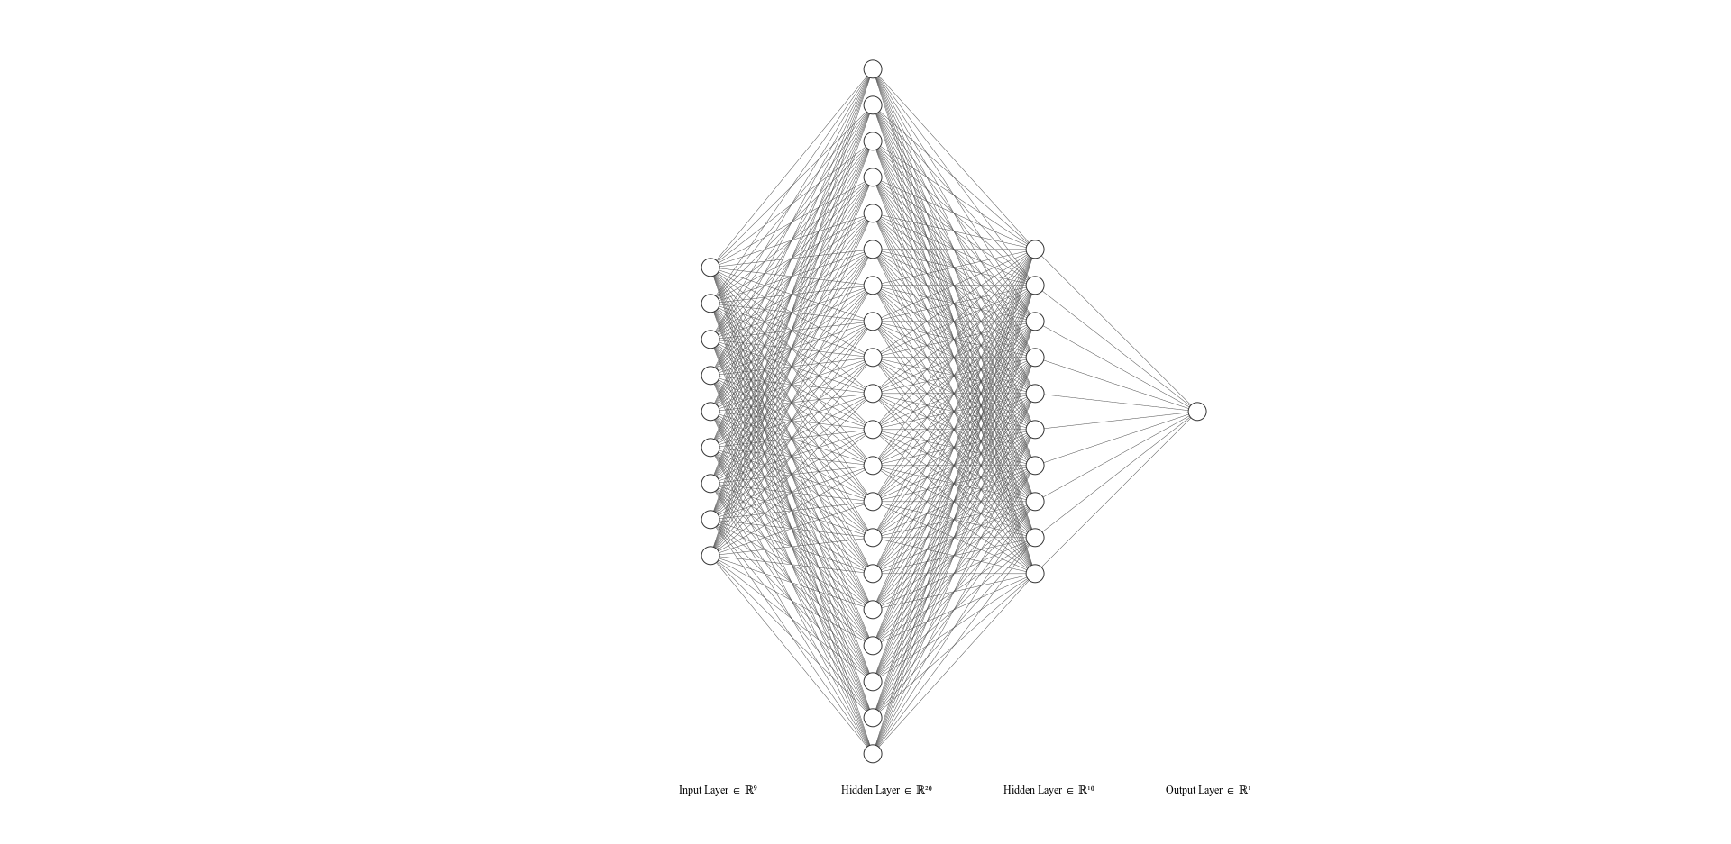
Algorithms/Methods
Neural Network
Classification Network with 9 inputs, 20 nodes in the first hidden layer 10 nodes in the second hidden layer and 1 output.
Each hidden layer had a batch normalization function applied to it. All layers excluding the input used a sigmoid activation function.
No Softmax function at output
Instead the outputs were rounded
100 Epochs
Batch Size of 50
Learning rate of 1e-5
Adam optimizer
BCE Loss
Model trained on 100,000 training samples and 15,000 testing samples
Also tried adding dropout layers to the network though the results were unaffected.

Slide 6
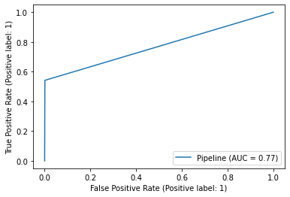
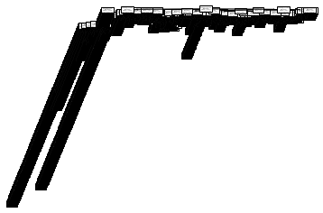
Results
Decision Tree
Confusion Matrix:
Accuracy: 0.9972
F1 Score: 0.9972
R2 Score: 0.275
MAE: 0.0028
552927 | 602
947 | 1198
(A bit counter intuitive but positive in this case is not fraud)
Had 602 false positives out of 1800 total negatives
Had 947 false negatives out of 553,874 total positives
Overall good model. Not perfect but has a very low error and good accuracy.

Slide 7
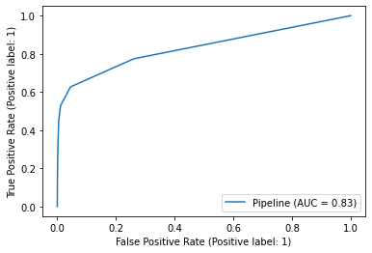
Results
Random Forest
Confusion Matrix
Accuracy: 0.996
F1 Score: 0.996
R2 Score: -0.0025
MAE: 0.0039
553568 | 6
2136 | 9
Defaults to nearly every result being 0 or ‘not fraud’. While Accuracy and error appear to be decent when considered in a vacuum, they’re not as good as the decision tree. Looking at the data as a whole we can tell the accuracy appearing good is mostly the result of low number of negative instances in the dataset.

Slide 8
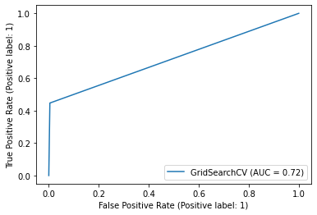
Results
Decision Tree (Post Hyperparameter Tuning)
Confusion Matrix
Accuracy: 0.996
F1 Score: 0.996
R2 Score: -0.0038
MAE: 0.0039
553574 | 0
2145 | 0
Model actually now always predicts every transaction to be not fraud. This is obviously sub-optimal and all scores are worse than standard decision tree.
Time to train random forest and perform hyperparameter tuning was also longer than training a standard decision tree for this instance making this model less optimal in essentially every way.

Slide 9
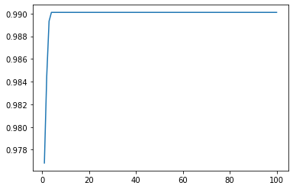
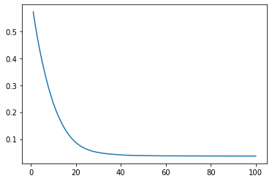
Results
Deep Neural Network (No dropout)
Accuracy vs # Epochs
Confusion Matrix
Accuracy: 0.9969
F1 Score: 0.9969
R2 Score: -0.003
MAE: 0.0226
14954 | 0
46 | 0
Training loss vs # Epochs
Worst performance yet, though that’s mostly due to the ratio in this particular sample.
Similarly to the random forest this model defaults to predicting every interaction as not fraud.
Likely due to the low percentage of fraud examples in training set (despite attempts to normalize data).

Slide 10
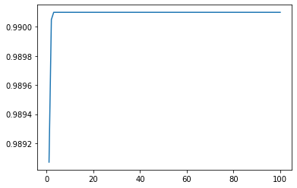
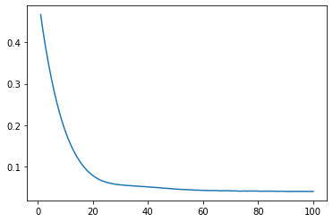
Results
Deep Neural Network (Dropout p=0.2)
Accuracy vs # Epochs
Confusion Matrix
Accuracy: 0.9969
F1 Score: 0.9969
R2 Score: -0.003
MAE: 0.0226
14954 | 0
46 | 0
Training loss vs # Epochs
Same results as without dropout layer. Possibly could try dropping a higher percentage of nodes in future attempts.

Slide 11
Results
Analysis
The best performer and fastest model to train was the decision tree.
In the future we could consider also training a linear regression model though was unable to get to that in the present project.
No model performed perfectly though the accuracy of the decision tree was decent.
Deep Neural Network possibly could still outperform the decision tree if allowed more samples to train on and with some more tweaking to the model.

